Slide 1

FUNDAMENTALS OF DATABASE SYSTEMS LESSON 3: The ER Model
University of Engineering and Technology,
Vietnam National University in Hanoi (UET-VNU)
hanhdp@vnu.edu.vn

Slide 2
Outline
Example Database Application (COMPANY)
ER Model Concepts
Entities and Attributes
Entity Types, Value Sets, and Key Attributes
Relationships and Relationship Types
Weak Entity Types
Roles and Attributes in Relationship Types
ER Diagrams - Notation
ER Diagram for COMPANY Schema

Slide 3
Some of the Currently Available Automated Database
Design Tools
COMPANY | TOOL | FUNCTIONALITY
Visio | Visio Enterprise | Data modeling, design and reengineering Visual Basic and Visual C++
Draw.io | Free online tool | https://about.draw.io/entity-relationship-diagrams-with-draw-io/

Slide 4
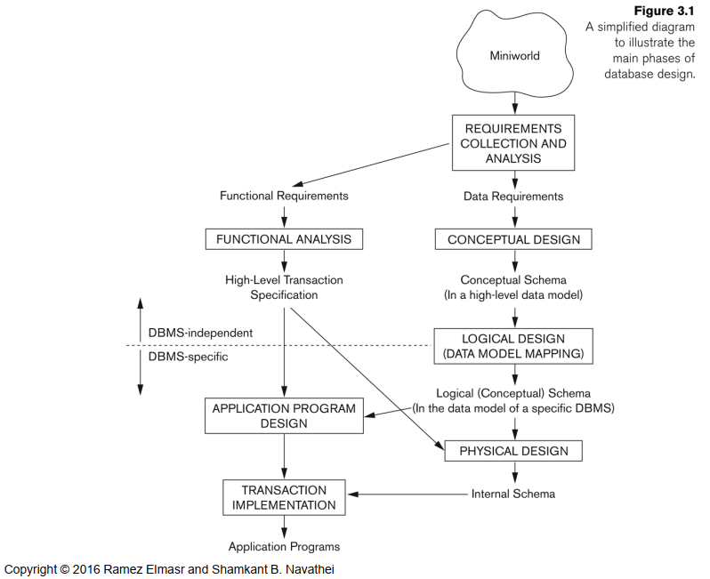
Overview of Database Design Process

Slide 5
Example COMPANY Database
Requirements of the Company (oversimplified for illustrative purposes)
The company is organized into DEPARTMENTs. Each department has a name, number and an employee who manages the department. We keep track of the start date of the department manager.
Each department controls a number of PROJECTs. Each project has a name, number and is located at a single location.

Slide 6
Example COMPANY Database (Cont.)
We store each EMPLOYEE’s social security number, address, salary, sex, and birthdate. Each employee works for one department but may work on several projects. We keep track of the number of hours per week that an employee currently works on each project. We also keep track of the direct supervisor of each employee.
Each employee may have a number of DEPENDENTs. For each dependent, we keep track of their name, sex, birthdate, and relationship to employee.

Slide 7
ER Model Concepts
Basis of an entity relationship diagram (ERD)
ERD depicts the:
Conceptual database as viewed by end user
Database’s main components
Entities
Attributes
Relationships
Entity - Refers to the entity set and not to a single entity occurrence

Slide 8
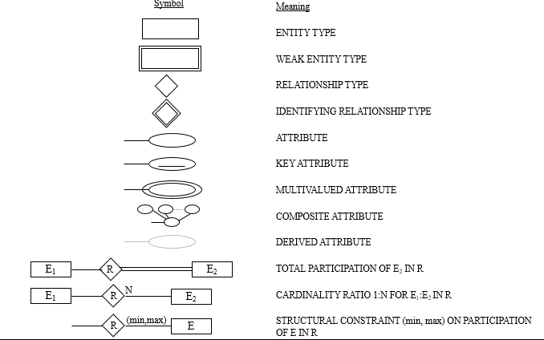
SUMMARY OF ER-DIAGRAM NOTATION FOR ER SCHEMAS

Slide 9
attributes

Slide 10
Types of Attributes
Simple
Each entity has a single atomic value for the attribute.
For example, SSN or Sex.
Composite
The attribute may be composed of several components.
For example, Address (Apt#, House#, Street, City, State, ZipCode, Country) or Name (FirstName, MiddleName, LastName). Composition may form a hierarchy where some components are themselves composite.
Multi-valued
An entity may have multiple values for that attribute.
For example, Color of a CAR or PreviousDegrees of a STUDENT. Denoted as {Color} or {PreviousDegrees}.

Slide 11
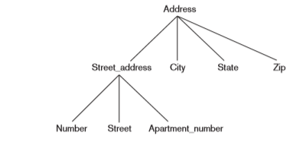
Types of Attributes
In general, composite and multi-valued attributes may be nested arbitrarily to any number of levels although this is rare. For example, PreviousDegrees of a STUDENT is a composite multi-valued attribute denoted by {PreviousDegrees (College, Year, Degree, Field)}.
A hierarchy of composite attributes

Slide 12
Types of Attributes
Stored vs Derived attributes: In some cases, two (or more) attribute values are related—for example, the Age and Birth_date attributes of a person. For a particular person entity, the value of Age can be determined from the current (today’s) date and the value of that person’s Birth_date. The Age attribute is hence called a derived attribute and is said to be derivable from the Birth_date attribute, which is called a stored attribute.

Slide 13
ENTITIES

Slide 14
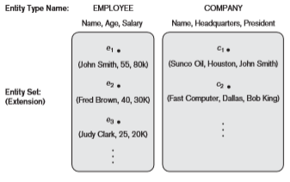
Entity Types and Key Attributes
Entities with the same basic attributes are grouped or typed into an entity type. For example, the EMPLOYEE entity type or the COMPANY entity type.

Slide 15
Key Attributes
An attribute of an entity type for which each entity must have a unique value is called a key attribute of the entity type. For example, SSN of EMPLOYEE.
A key attribute may be composite. For example, VehicleTagNumber is a key of the CAR entity type with components (Number, State).
An entity type may have more than one key. For example, the CAR entity type may have two keys:
VehicleIdentificationNumber (popularly called VIN) and
VehicleTagNumber (Number, State), also known as license_plate number.

Slide 16
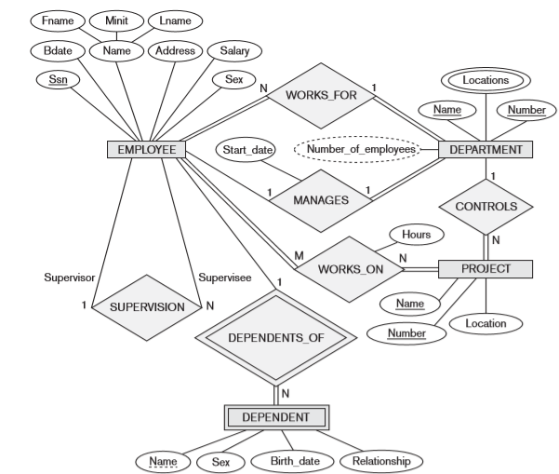
ER DIAGRAM – Entity Types are: EMPLOYEE, DEPARTMENT, PROJECT, DEPENDENT

Slide 17
Weak Entity Types
An entity that does not have a key attribute
A weak entity must participate in an identifying relationship type with an owner or identifying entity type
Entities are identified by the combination of:
A partial key of the weak entity type
The particular entity they are related to in the identifying entity type
Example:
Suppose that a DEPENDENT entity is identified by the dependent’s first name and birhtdate, and the specific EMPLOYEE that the dependent is related to. DEPENDENT is a weak entity type with EMPLOYEE as its identifying entity type via the identifying relationship type DEPENDENT_OF

Slide 18
Weak Entity Type is: DEPENDENT Identifying Relationship is: DEPENDENTS_OF

Slide 19
RELATIONSHIP

Slide 20
Relationships and Relationship Types
A relationship relates two or more distinct entities with a specific meaning. For example, EMPLOYEE John Smith works on the ProductX PROJECT or EMPLOYEE Franklin Wong manages the Research DEPARTMENT.
Relationships of the same type are grouped or typed into a relationship type. For example, the WORKS_ON relationship type in which EMPLOYEEs and PROJECTs participate, or the MANAGES relationship type in which EMPLOYEEs and DEPARTMENTs participate.

Slide 21
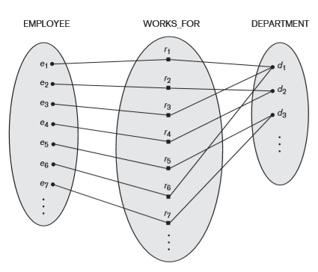
Example relationship instances of the WORKS_FOR relationship between EMPLOYEE and DEPARTMENT

Slide 22
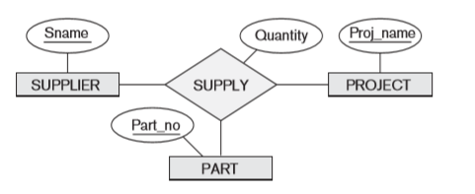
Relationships and Relationship Types
The degree of a relationship type is the number of participating entity types. Both MANAGES and WORKS_ON are binary relationships.
A relationship type of degree two is called binary, and one of degree three is called ternary.

Slide 23
Relationships and Relationship Types
More than one relationship type can exist with the same participating entity types.
For example, MANAGES and WORKS_FOR are distinct relationships between EMPLOYEE and DEPARTMENT, but with different meanings and different relationship instances.

Slide 24
ER DIAGRAM – Relationship Types are: WORKS_FOR, MANAGES, WORKS_ON, CONTROLS, SUPERVISION, DEPENDENTS_OF

Slide 25
Constraints on Relationships
Constraints on Relationship Types
( Also known as ratio constraints )
Maximum Cardinality
One-to-one (1:1)
One-to-many (1:N) or Many-to-one (N:1)
Many-to-many
Minimum Cardinality (also called participation constraint or existence dependency constraints)
zero (optional participation, not existence-dependent)
one or more (mandatory, existence-dependent)

Slide 26
Total vs partial participation
The participation of EMPLOYEE in WORKS_FOR is called total participation, meaning that every entity in the total set of employee entities must be related to a department entity via WORKS_FOR. Total participation is also called existence dependency.
The participation of EMPLOYEE in the MANAGES relationship type is partial, meaning that some or part of the set of employee entities are related to some department entity via MANAGES, but not necessarily all.

Slide 27
Relationships and Relationship Types
We can also have a recursive relationship type.
Both participations are same entity type in different roles.
For example, SUPERVISION relationships between EMPLOYEE (in role of supervisor or boss) and (another) EMPLOYEE (in role of subordinate or worker).
In following figure, first role participation labeled with 1 and second role participation labeled with 2.
In ER diagram, need to display role names to distinguish participations.

Slide 28
Recursive Relationship Type is: SUPERVISION (participation role names are shown)

Slide 29
Attributes of Relationship types
A relationship type can have attributes; for example, HoursPerWeek of WORKS_ON; its value for each relationship instance describes the number of hours per week that an EMPLOYEE works on a PROJECT.

Slide 30
Attribute of a Relationship Type is: Hours of WORKS_ON

Slide 31
Structural Constraints – one way to express semantics of relationships
Structural constraints on relationships:
Cardinality ratio (of a binary relationship): 1:1, 1:N, N:1, or M:N
SHOWN BY PLACING APPROPRIATE NUMBER ON THE LINK.
Participation constraint (on each participating entity type): total (called existence dependency) or partial.
SHOWN BY DOUBLE LINING THE LINK
NOTE: These are easy to specify for Binary Relationship Types.

Slide 32
Alternative (min, max) notation for relationship structural constraints:
Specified on each participation of an entity type E in a relationship type R
Specifies that each entity e in E participates in at least min and at most max relationship instances in R
Default(no constraint): min=0, max=n
Must have min≤max, min≥0, max ≥1
Derived from the knowledge of mini-world constraints
Examples:
A department has exactly one manager and an employee can manage at most one department.
Specify (0,1) for participation of EMPLOYEE in MANAGES
Specify (1,1) for participation of DEPARTMENT in MANAGES
An employee can work for exactly one department but a department can have any number of employees.
Specify (1,1) for participation of EMPLOYEE in WORKS_FOR
Specify (0,n) for participation of DEPARTMENT in WORKS_FOR

Slide 33
The (min,max) notation relationship constraints
(0,1)
(1,1)
Employee
Manages
Department
(1,1)
(1,N)
Employee
Department
Works-for

Slide 34
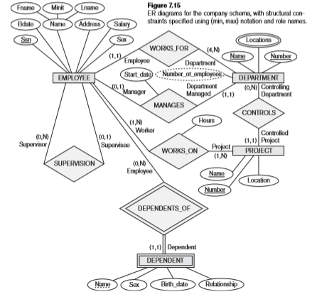

Slide 35
Relationships of Higher Degree
Relationship types of degree 2 are called binary
Relationship types of degree 3 are called ternary and of degree n are called n-ary
In general, an n-ary relationship is not equivalent to n binary relationships

Slide 36
Home work
Exercise 1:
Consider the following set of requirements for a UNIVERSITY database that is used to keep track of students’ transcripts.
The university keeps track of each student’s name, student number, Social Security number, current address and phone number, permanent address and phone number, birth date, sex, class (freshman, sophomore,...,graduate),major department, minor department (if any),and degree program (B.A., B.S., ..., Ph.D.). Some user applications need to refer to the city, state, and ZIP Code of the student’s permanent address and to the student’s last name. Both Social Security number and student number have unique values for each student.
Each department is described by a name, department code, office number, office phone number, and college. Both name and code have unique values for each department.
Each course has a course name, description, course number, number of semester hours, level, and offering department. The value of the course number is unique for each course.
Each section has an instructor, semester, year, course, and section number. The section number distinguishes sections of the same course that are taught during the same semester/year; its values are 1, 2, 3, ...,up to the number of sections taught during each semester.
A grade report has a student, section, letter grade, and numeric grade (0, 1,2,3,or 4).
Design an ER schema for this application, and draw an ER diagram for the schema. Specify key attributes of each entity type, and structural constraints on each relationship type. Note any unspecified requirements, and make appropriate assumptions to make the specification complete.

Slide 37
Home work
Exercise 2:
Consider a MAIL_ORDER database in which employees take orders for parts from customers. The data requirements are summarized as follows:
The mail order company has employees, each identified by a unique employee number, first and last name, and Zip Code.
Each customer of the company is identified by a unique customer number, first and last name, and Zip Code.
Each part sold by the company is identified by a unique part number, a part name, price, and quantity in stock.
Each order placed by a customer is taken by an employee and is given a unique order number. Each order contains specified quantities of one or more parts. Each order has a date of receipt as well as an expected ship date. The actual ship date is also recorded.
Design an Entity-Relationship diagram for the mail order database and build the design using a data modeling tool.

Slide 38
Home work
Exercise 3:
Consider a MOVIE database in which data is recorded about the movie industry. The data requirements are summarized as follows:
Each movie is identified by title and year of release. Each movie has a length in minutes. Each has a production company, and each is classified under one or more genres (such as horror, action, drama, and so forth). Each movie has one or more directors and one or more actors appear in it. Each movie also has a plot outline. Finally, each movie has zero or more quotable quotes, each of which is spoken by a particular actor appearing in the movie.
Actors are identified by name and date of birth and appear in one or more movies. Each actor has a role in the movie.
Directors are also identified by name and date of birth and direct one or more movies. It is possible for a director to act in a movie (including one that he or she may also direct).
Production companies are identified by name and each has an address. A production company produces one or more movies.
Design an Entity-Relationship diagram for the movie database and enter the design using a data modeling tool.

Slide 39


